Slide 1
Operating System
Experiment I

Slide 2
Tutorial I (26.1.2018)
Describe the concept of process. (5 marks)
Illustrate the process structure with diagram. (10 marks)
Explain the process control block (PCB) with diagram. (10 marks)

Slide 3
Switch a Computer
POST – power On Self Text.
BIOS – Basic Input Output System
Searches OS
BOOTING – Transfer of operating system form disk to memory.

Slide 4
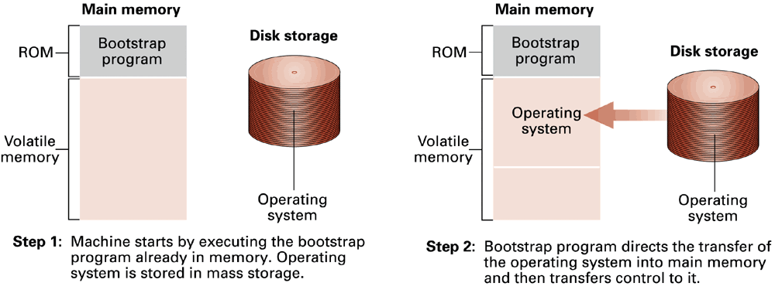
Disk Boot Process

Slide 5
Disk Boot Process
MSDOS.SYS
BIOS
IO.SYS
COMMAND.COM
Bootstrap program
SYSINIT
CONFIG.SYS
AUTOEXEC.BAT

Slide 6
To open MS DOS
Click on Start Button
Go to Programs Menu
Click on MS DOS Prompt option
Type CD.. and Press Enter Key (↵)

Slide 7
Internal DOS commands
C:\> CLS ↵
C:\> DATE ↵
C:\> TIME ↵
C:\> VOL ↵
C:\> VER ↵
C:\> PROMPT <Prompt text> ↵
C:\> PROMPT AISECT ↵
AISECT PROMPT $P$G ↵

Slide 8
DIR Option
C:\> DIR ↵
dir/p
dir/w
dir/p/w
dir/aa
dir/ar
dir/ah

Slide 9
DIR Option
dir/as
dir/ad
dir/l
dir/s
dir <filename>
dir <directory name>

Slide 10
Wild Card Characters
* and ? are wild card characters

